Slide 1
Management 515
Evolution of
Management Thought
© 2014, 2016 David E. Frick.
All rights reserved.

Slide 2
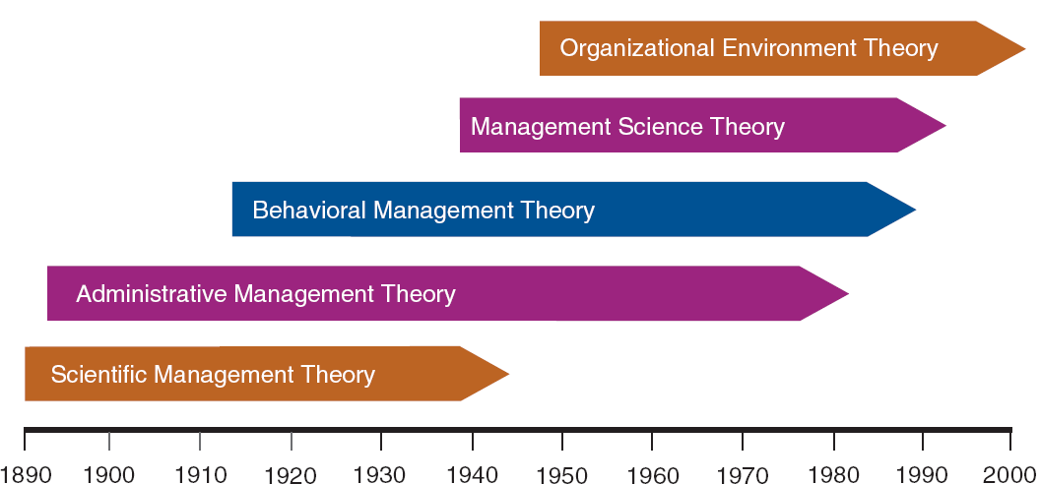
Timelines
Adapted from Contemporary Management, 8th, G.R. Jones & J.M. George
Notes:
The concept of management is an invention of man. In the last 100 years, five major theories of management have been accepted.
“Management books tend to focus on the function of management inside of organizations. Few yet accept that it is a social function. But it is precisely because management has become so pervasive as a social function that it faces it most serious challenge.”
“Management is about human beings. Its task is to make people capable of joint performance, to make their strengths effective and their weakness irrelevant. This is what organization is all about.”
“Every enterprise is composed of people with different skills and knowledge doing many different kinds of work. It must be built on communications and individual responsibility.”
(Drucker. The Essential Drucker, p. 9-11)

Slide 3
Scientific Management Theory
The systematic study of the relationships between people and tasks for the purpose of redesigning the work process to increase efficiency
Principal work of F. W. Taylor
Problems
Managers frequently implemented only the increased output side of Taylor’s plan. Workers did not share in the benefits of increased output
Specialized jobs became very boring and dull. Workers ended up distrusting the Scientific Management method
Notes:
Scientific management theory professes four steps:
1. Study the way workers perform their tasks, gather all the informal job knowledge that workers possess and experiment with ways of improving how tasks are performed, e.g., Time-and-motion study
2. Codify the new methods of performing tasks into written rules and standard operating procedures
3. Carefully select workers who possess skills and abilities that match the needs of the task, and train them to perform the task according to the established rules and procedures
4. Establish a fair or acceptable level of performance for a task, and then develop a pay system that provides a reward for performance above the acceptable level
Workers could (and did) purposely “under-perform.” This was common is environments where labor unions existed. Workers were encouraged to meet the minimum standard and no more. Exceeding the standard could make other workers look bad or encourage management to raise the standard.
Management responded with increased use of machines and other automation.

Slide 4
Job Specialization & Division of Labor
Adam Smith (18th century economist). Observed that firms manufactured pins in one of two different ways:
Craft-style—each worker did all steps
Production—each worker specialized in one step
Smith found that the performance of the factories in which workers specialized in only one or a few tasks was much greater than the performance of the factory in which each worker performed all pin-making tasks
Theory became widely accepted as a consequence of World War I
Notes:
This was the beginning of the of assembly line thought.
In Wealth of Nations, Adam Smith spoke of a straight pin factory. In pin-making a single person completing all steps could scarcely make 1 pin a day, much less 20. But with division of labor into a series of 18 production steps, a work group can make upwards of 48 thousand pins a day. In the specific case, the factory was able to increase production by a factor of 200.
The division of labor is more prevalent in highly industrialized countries, especially in manufacturing. It's advantage it that it increases the dexterity of every workman, saves time, and uses human-labor facilitating machinery.
The improvement of dexterity increases the quantity of work a person can perform by reducing work to a single operation that they can quickly master.
Through division of labor workers can produce large quantities of goods (more than if they produced the entire good by themselves), the fruits of which they can use to buy goods from other specialized people. This increases the opulence of the entire society.
Large numbers of unskilled, pre-industrial people had to be made productive in a short time. Scientific management was used to implement the systematic training and application of blue-collar workers on a large scale. The assembly line was a short-term compromise. Even though the assembly line is highly efficient, its inflexibility and poor use of human resources can lead to ineffectiveness. (Drucker. The Essential Drucker, p. 6-7)

Slide 5
Definitions
Job Specialization. Process by which a division of labor occurs as different workers specialize in different tasks over time
Take the job and divide it up into logical parts
Optimize each sub-process
Train individuals to mastery in one sub-process
Arrange sub-processes to fit together

Slide 6
Administrative Management Theory
The study of how to create an organizational structure and control system that leads to high efficiency and effectiveness
Organizational structure: System of task and authority relationships that control how employees use resources to achieve the organization’s goals
Max Weber (1864-1920). Developed the principles of bureaucracy as a formal system of organization and administration designed to ensure efficiency and effectiveness. Father of sociology. Influenced Marx and Hitler

Slide 7
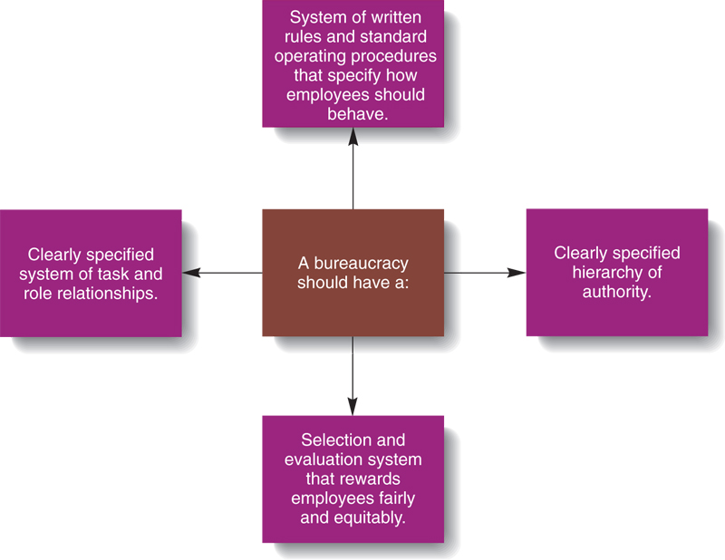
Weber Principles
Notes:
A manager’s formal authority derives from the position in the organization
People should occupy positions because of their performance, not because of their social standing or personal contacts
The extent of each position’s formal authority and task responsibilities and it’s relationship to other positions should be clearly specified
Authority can be exercised effectively when positions are arranged hierarchically, so employees know whom to report to and who reports to them
Managers must create a well-defined system of rules, standard operating procedures, and norms so they can effectively control behavior

Slide 8
Rules, SOPs, and Norms
Rules. Written instructions that specify actions to be taken under different circumstances to achieve specific goals
Standard (or Standing) Operating Procedures (SOPs). Specific sets of written instructions about how to perform a certain aspect of a task
Norms. Unwritten, informal codes of conduct that prescribe how people should act in particular situations

Slide 9
Fayol’s Principles of Management
Division of labor. Job specialization and the division of labor should increase efficiency, especially if managers take steps to lessen workers’ boredom
Authority and responsibility. Managers have the right to give orders and the power to compel subordinates
Unity of command. An employee should receive orders from only one superior
Line of authority. The length of the chain of command that extends from the top to the bottom of an organization should be limited

Slide 10
More Principles
Decentralization. Authority should not be concentrated at the top of the chain of command
Unity of direction. The organization should have a single plan of action to guide managers and workers (a strategy)
Equity. All organizational members are entitled to be treated with justice and respect
Order. The arrangement of organizational positions should maximize organizational efficiency and provide employees with satisfying career opportunities

Slide 11
Still More Principles
Initiative. Managers should allow employees to be innovative and creative
Discipline. Managers need to create a workforce that strives to achieve organizational goals
Remuneration of personnel. The system that managers use to reward employees should be equitable for both employees and the organization (Equity Theory)
Stability of tenure of personnel. Long-term employees develop skills that can improve organizational efficiency

Slide 12
And the Rest
Subordination of individual interests to the common interest. Employees should understand how their performance affects the performance of the whole organization (linking job tasks to strategy)
Esprit de corps. Managers should encourage the development of shared feelings of comradeship, enthusiasm, or devotion to a common cause (culture)

Slide 13
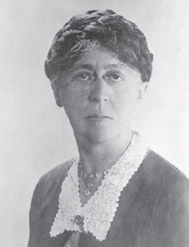
Behavioral Management Theory
The study of how managers should personally behave to motivate employees and encourage them to perform at high levels and be committed to the achievement of organizational goals
Mary Parker Follett. Concerned that Taylor ignored the human side of the organization
Suggested workers help in analyzing their jobs
If workers have relevant knowledge of the task, then they should control the task
Touchy-feely side of management
Notes:
Behavioral management theory emerged because employee behavior and motivation was ignored at the time of classical theory.
Behavioral management theory completely revolves around the behavior of the managers and employees. It purports that every employee and manager should be given equal chance to express views and ideas and should be motivated at every single step.
Tied to Maslow’s Hierarchy of Needs.

Slide 14
Hawthorne Studies
Studied how work setting affected worker fatigue and performance at the Hawthorne Works of the Western Electric Company from 1924-1932
Worker productivity was measured at various levels of light illumination
Researchers found that regardless of light levels, worker productivity increased
If workers think they are being watched, performance improves
Bottom line: Mangers can influence worker productivity
Notes:
View: https://www.youtube.com/watch?v=EEwCWR5Vkpw

Slide 15
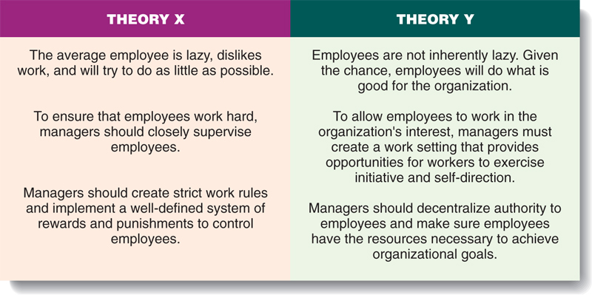
Theory X vs. Theory Y
Notes:
View this video: https://www.youtube.com/watch?v=NK8-LhqF4N0
Theory X Theory Y is not comprehensive. However, I want you to understand these theories to put things that you observe in context.
For example, take a policy that requires employees to get permission from a supervisor to visit the restroom. I hope you agree this is a Theory X-type policy.
Now, assume that you and your colleagues are basically Theory Y-type employees.
How do you think this new policy will affect how you think of your employer and on your performance.

Slide 16
Management Science Theory
Contemporary approach to management that focuses on the use of rigorous quantitative techniques to help managers make maximum use of organizational resources to produce goods and services
The theory holds that managing is a logical and rationale process that can be expressed in terms of mathematical models
“All models are wrong, but some are useful”
--George E. P. Box
Notes:
Management Science Theory gives a quantitative basis for decision making. It specially deals with the development of mathematical models to aid in decision making and problem solving. This theory holds that managing is a logical and rationale process, so it can be expressed in terms of mathematical models
Most scholars of management hold two sets of assumptions:
1.
Management is business management
There is—or there must be—one right organizational structure
There is—or there must be—one right way to manage people
2.
Technologies, markets, and end users are given
Management scope is legally defined
Management is internally focused
The economy is defined by national boundaries is the ecology of enterprise and management (Drucker. The Essential Drucker. 2001)

Slide 17
Elements
Quantitative management. Uses mathematical techniques to support decision making
Operations management. Techniques to analyze an organization’s production system to increase efficiency
Process Improvement. Focuses on analyzing an organization’s input, conversion, and output activities to increase product quality, e.g., MBO, Quality, CPI, Six Sigma, Lean
Management information systems. Systems that provide information that is vital for effective decision making

Slide 18
Organizational Environment Theory
Addresses the environment external to the firm as primary influencers of organizational efficiency
Organizational Environment. The set of forces and conditions that operate beyond an organization’s boundaries but affect a manager’s ability to acquire and use resources
Organizational domain. The goods and services that the organization produces, and the customers and other stakeholders whom it serves
Sources of environmental uncertainty. Complexity, dynamism, and richness
Notes:
Considers relationships inside and outside the organization: The environment consists of forces, conditions, and influences outside the organization.
The theory considers the impact of stages:
Input: acquire external resources. Conversion: inputs are processed into goods and services. Output: finished goods are released into the environment.

Slide 19
Model
International Forces
Demographic / Cultural Forces
Political Forces
Customers
Distributors
Suppliers
Organization
Unions
Government
Competitors
Environmental Forces
Technological Forces
Economic Forces
General Forces
Specific Forces
Notes:
Here is a picture of the model. Each of these boxes is different for each organization. The model demands that managers consider and act upon each and every element of the model.

Slide 20
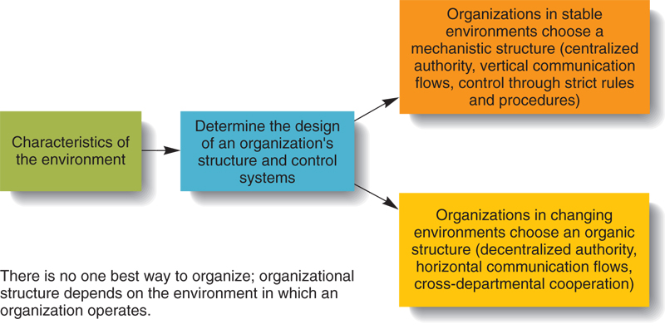
Contingency Theory
The idea that the organizational structures and control systems manager choose are contingent on characteristics of the external environment in which the organization operates
Notes:
Contingency Theory has sought to formulate broad generalizations about the formal structures that are typically associated with different technologies. The perspective originated with the work of Joan Woodward (1958), who argued that technologies directly determine differences in such organizational attributes as span of control, centralization of authority, and the formalization of rules and procedures. Some important contingencies for companies are listed below:
Technology
Suppliers and distributors
Consumer interest groups
Customers and competitors
Government
Unions

Slide 21
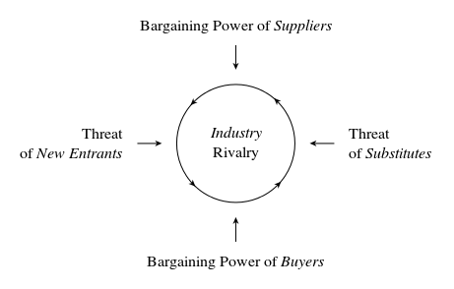
Porter’s Five Forces Model
Notes:
You have seen this before> If you have forgotten, view:
https://www.youtube.com/watch?v=uvwjip3CTMA

Slide 22
Systems Theory in Business
Systems Theory in business—subset of Systems Theory
What is a system
Collection of parts
Removing a part changes the system
Systems convert inputs into outputs
Managers must understand the forces working inside the black box
Encourages managers to interpret patterns and events
Notes:
Systems theory is the interdisciplinary study of systems in general. Systems theory poses the question, “what is a system?” A system is a collection of parts unified to accomplish an overall goal. If one part of the system is removed, the nature of the system is changed.
Systems theory may seem quite basic. Only recently, with tremendous changes facing organizations and how they operate, have educators and managers come to face this new way of looking at things. This interpretation has brought about a significant change in the way management studies and approaches organizations.
The effect of Systems Theory in management is that writers, educators, and consultants are helping managers to look at the organization from a broader perspective. Systems theory has brought a new perspective for managers to interpret patterns and events in the workplace.

Slide 23
Chaos Theory in Business
Chaos Theory in business—subset of Chaos Theory
Events in business are:
Random
Unpredictable
Business system naturally become more complex
Greater complexity leads to more costs
Uncheck complexity growth will lead to organizational death
Notes:
Chaos Theory in business is a subset of general Chaos Theory. As chaotic and random as world events seem today, they seem as chaotic in organizations, too. Yet for decades, managers have acted on the basis that organizational events can always be controlled. A new theory (or some say “science”), chaos theory, recognizes that events indeed are rarely controlled. Many chaos theorists (as do systems theorists) refer to biological systems when explaining their theory. They suggest that systems naturally go to more complexity, and as they do so, these systems become more volatile (or susceptible to cataclysmic events) and must expend more energy to maintain that complexity. As they expend more energy, they seek more structure to maintain stability. This trend continues until the system splits, combines with another complex system or falls apart entirely. Sound familiar? This trend is what many see as the trend in life, in organizations and the world in general.

